Slide 1
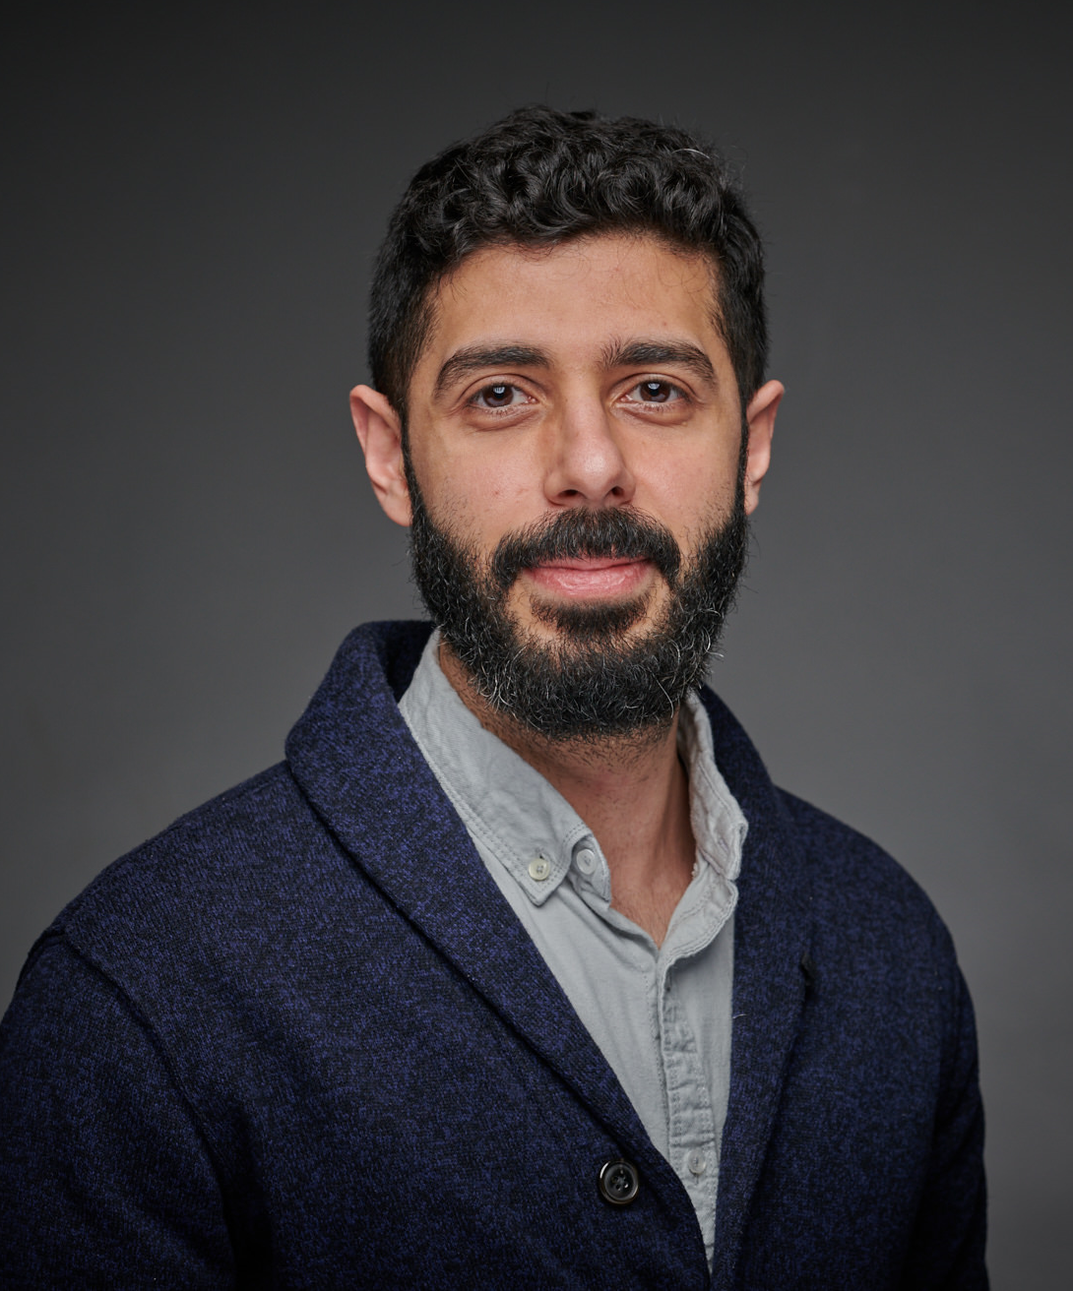
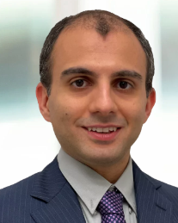
Graduate Seminar
GUEST SPEAKERS
Saj Salam, Ph.D., P.E.
Managing Engineer
Civil & Structural Engineering
Exponent, Oakland
Mehrdad Shokrabadi, Ph.D., P.E.
Senior Engineer
Civil & Structural Engineering
Exponent, Irvine
Forensic Engineering and Failure Investigations
Wednesday,
May 14th
12:00 - 13:00 PM
Seminar Abstract: This presentation will cover the basics of forensic engineering and performing geo-structural failure investigations. Example investigations will be presented including a lateral movement of retaining wall during pile driving, viaduct collapse, and seepage behavior from fluctuating river levels among others.
About the Speakers: Dr. Salam specializes in computational geomechanics, numerical and analytical analysis of geosystems, and condition assessment of geotechnical assets. His expertise encompasses natural and man-made slopes, embankments, retaining structures, roads and highways, ground improvement, and earth dams. Dr. Salam is adept at providing both reactive and proactive consultation, alongside risk assessment for geotechnical assets. Dr. Salam leverages his multidisciplinary background in engineering and statistics to deliver innovative solutions for civil and geotechnical engineering applications.
Dr. Shokrabadi specializes in performance-based earthquake engineering, natural hazard recognition and mitigation, and nonlinear modeling and analysis of various structural systems. At Exponent, Dr. Shokrabadi's work has focused on devising probabilistic risk frameworks for utility providers, consultation on international arbitration matters and damage assessment of residential and commercial structures.

